Slide 1


Bank Loan Case Study Final Project-2
PRACHI SHINDE

Slide 2

Agenda
APPROACH
TECH-STACK USED
PROJECT DESCRIPTION
INSIGHTS
RESULTS

Slide 3

PROJECT DESCRIPTION

Slide 4

PROJECT DESCRIPTION
Analyze loan application data using EDA to identify patterns in customer and loan attributes that influence defaults. The goal is to reduce risks by ensuring capable applicants are approved while minimizing defaults from risky borrowers.

Slide 5



APPROACH

Slide 6

APPROACH
.Understanding the data (application_data.csv)
Cleaning the Dataset(Removing duplicates, unnecessary rows and columns)
Imputation
Analyzing and Visualizing the dataset.
Conclusion.
LOOM VIDEOS: TASK1 AND 2
https://www.loom.com/share/dcb8afad579546b5981fe52f74e9f85a?sid=e1814b99-a706-4dc2-b618-67e46bebeace
TASK 3 , 4,
https://www.loom.com/share/d4676f31737443b0b9847cd28ea79b4b?sid=2c57260d-83ed-46f0-8634-0572b7c590c3
TASK 5 AND CONCLUSION
https://www.loom.com/share/cbeca96e0d8745259a65978677f3f920?sid=5044c8e4-7720-441c-833b-c9234a3f949e

Slide 7

TECH-STACK USED

Slide 8

TECH-STACK USED
MICROSOFT EXCEL 2022

Slide 9


INSIGHTS

Slide 10
TASK 1
Identify Missing Data and Deal with it Appropriately: As a data analyst, you come across missing data in the loan application dataset. It is essential to handle missing data effectively to ensure the accuracy of the analysis.
Task: Identify the missing data in the dataset and decide on an appropriate method to deal with it using Excel built-in functions and features.

Slide 11
TASK 1 INSIGHTS
Importing data from application_data.csv file :- The data provided to us initially had 122 columns and 50000 rows.
Firstly we checked for duplicate rows with the remove duplicates in data tab – no duplicates were found.
Then we calculated the percentage of blank cells in each column using function COUNTBLANK AND COUNTA.
Formula:- COUNTBLANK(A3:A50001)/COUNTA(A3:A50001)*100
Using this formula we got the percent of blank values in each column.
4. Using conditional formatting we highlighted the cells having >30% of blank values and deleted those columns.
5. Using conditional formatting we highlighted blank cells.
6. For numerical values we used MEDIAN of the column and for column Name_type_suite the blanks were filled with “unaccompanied”.

Slide 12
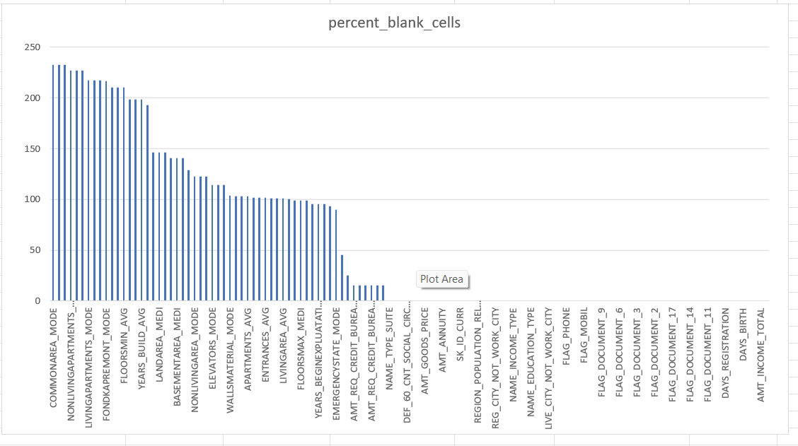
TASK 1

Slide 13
TASK 2
Identify Outliers in the Dataset: Outliers can significantly impact the analysis and distort the results. You need to identify outliers in the loan application dataset.
Task: Detect and identify outliers in the dataset using Excel statistical functions and features, focusing on numerical variables.

Slide 14
TASK 2 INSIGHTS
Outliers: Formulas:
For Quartile1=QUARTILE(Range,1)
For Quartile3=QUARTILE(Range,3)
InterQuartileRange(IQR)=Q3-Q1
Upper Bound=Q3+(1.5*IQR)
Lower Bound=Q1-(1.5*IQR)
For determining outliers =IF(OR([FIRST CELL IN COLUMN]<[LOWERBOUNDCELL],[FIRST CEII IN COLUMN].[UPEER BOUND],”OUTLIER”,”NORMAL”)
Outliers can be seen in Amt_Income_total. The 3rd quartile is very slim for Income Amount.
Outliers can be seen in Amt_Annuity. The 1st quartile is bigger than 3rd quartile which means most of the annuity clients are from 1st quartile.
Outliers can be seen in Amt_Credit. The 3rd quartile is bigger than 1st quartile which means most of the credits of clients are present in 3rd quartile.
Similarly, Outliers can be seen in Amt_Goods_Price. The 3rd quartile is bigger than 1st quartile which means most of the goods prices are sold in 3rd quartile.
There are no Outliers present in Days_Birth and Days_ID_Publish. All the values are within the range.

Slide 15
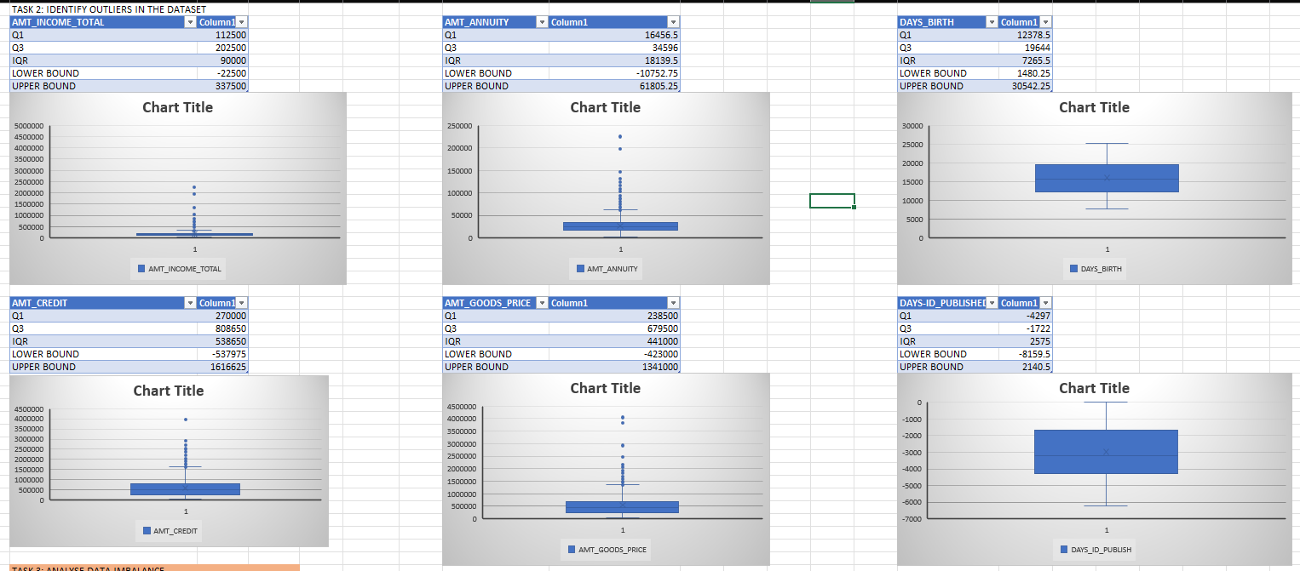
TASK 2 RESULT

Slide 16
TASK 3
Analyze Data Imbalance: Data imbalance can affect the accuracy of the analysis, especially for binary classification problems. Understanding the data distribution is crucial for building reliable models.
Task: Determine if there is data imbalance in the loan application dataset and calculate the ratio of data imbalance using Excel functions.

Slide 17
TASK 3 INSIGHTS
Data Imbalance occurs when data is disseminated in an unequal manner.
Formula to calculate Imbalance ratio:
=(Value1/Value2)&”:”&(Value2/Value2)
The Loan Default Chart shows highly data imbalance of 11.41:1 for the Loan Payers and Defaulters.
From the Code_Gender, we can see there are more number of females compared to males and the ratio is 1.9:1

Slide 18
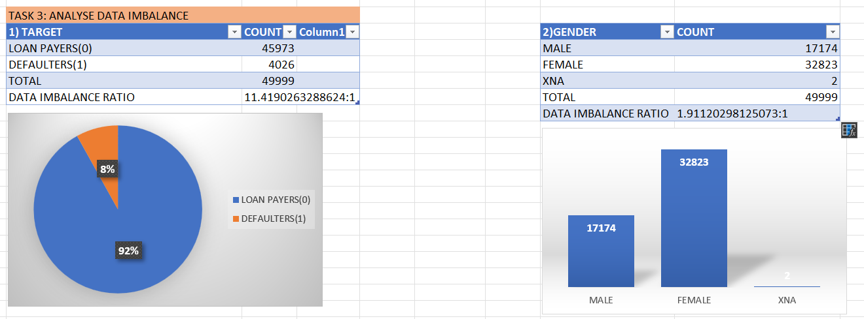
TASK 3 RESULT

Slide 19
TASK 4
Perform Univariate, Segmented Univariate, and Bivariate Analysis: To gain insights into the driving factors of loan default, it is important to conduct various analyses on consumer and loan attributes.
Task: Perform univariate analysis to understand the distribution of individual variables, segmented univariate analysis to compare variable distributions for different scenarios, and bivariate analysis to explore relationships between variables and the target variable using Excel functions and features.

Slide 20
TASK 4 INSIGHTS
Univariate Analysis: It is a form of analysis that only involves a single variable. It describes and gives insights about the patterns of individual variable.
For this Analysis, First consider the respected column, used pivot table and grouped them accordingly and plotted the graph.
For Amt_Income_Total, the highest number of people taking loans were in the income group of 100000-200000. Individuals with high income are less likely to apply for loans.
For Amt_Credit, the maximum credit amount of a bank loan lies in the range of 45000- 1045000.
For Age, the majority of loan applicants lies have come from people between the age of 35-50.
For Family_Status, those who are married have taken out more loans than others But, this analysis can’t describe about the loan takers or the majority of loan applicants in the age group of 35-50 are male or female. Similarly, the married people are loan payers or defaulters.

Slide 21
TASK 4 INSIGHTS
Segmented Univariate Analysis:
In this Analysis, we segment the categorical variables and then perform univariate analysis across its categories.
In this Analysis, first considered two columns, created pivot table with class intervals and plotted the graph.
We can analyze that as the income increases comparatively the loan defaulters are less.
As the credit amount increase, the number of defaulters also decrease.
The defaulters decreases as the age increases.
Most number of loans are taken by married people and the married or widow customers have less number of loan defaulters.

Slide 22
TASK 4 INSIGHTS
Segmented Univariate Analysis:
To calculate the number of years of employment, the outliers(1001 year) were removed and then the created the pivot table.
For Years Employed, people who are employed for more number of years are less likely to default loans.
According to Education, higher the education level, the number of defaulters is less.
Comparatively, people who have higher education tend to default less on their loans.
For Housing, people living in rented apartments or with parents have higher number of loan defaults compared to people living in apartments or houses.
For Contract type, people who took revolving loans have lower loan defaults compared to people who took cash loans

Slide 23
TASK 4 INSIGHTS
Bivariate Analysis: It refers to the study of analysis of two variables.
For this analysis, first considered two columns, created pivot table taking average of the variables with class intervals and plotted the graph.
From the graph, we can analyze that the age group of 45-50 are more likely to take higher loan amounts while the age group of 65-70 has less number of loan takers.
More females have taken loans compared to males and their loan default percentage is also less.
But, the average loan amount taken by male is more than female.
The customers who are having the income between 700000-800000 are the highest average loan amount takers.
But, we can’t define if the income increases the loan amount also increases. Married people tend to take higher loan amount compared to others.

Slide 24
TASK 5
Identify Top Correlations for Different Scenarios: Understanding the correlation between variables and the target variable can provide insights into strong indicators of loan default.
Task: Segment the dataset based on different scenarios (e.g., clients with payment difficulties and all other cases) and identify the top correlations for each segmented data using Excel functions.

Slide 25
TASK 5 INSIGHTS
Correlation for different Scenarios: To find the correlation, created separate data using target-1 and 0.
By using Data Analysis under the data tab, selected correlation and formed the correlation matrix between the data and used the conditional formatting to select the highest and lowest correlation.
Correlation for Target-0(Loan Payees): The highest correlation was found between Amt_Goods_Price and Amt_Credit which shows that if the goods price is more then they will be taking more credit.
Correlation for Target-1(Loan Defaulters): Here, also the highest correlation was found between Amt_Goods_Price and Amt_Credit. In both the Matrix, the lowest correlation was between Days_Employed and Days_Birth.

Slide 26
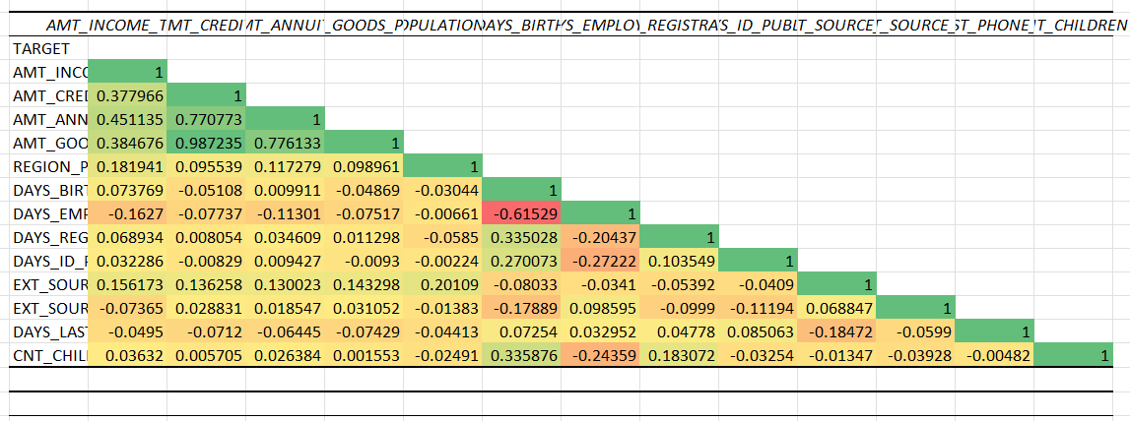
TASK 5 RESULTS

Slide 27
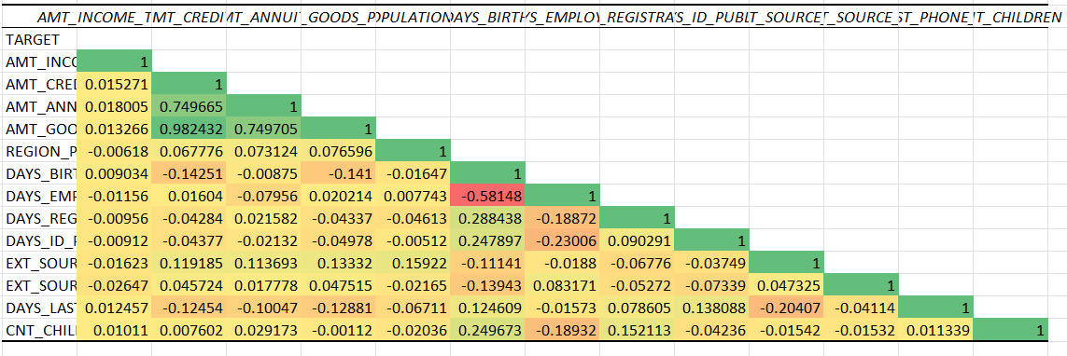
TASK 5 RESULT

Slide 28


CONCLUSION

Slide 29
CONCLUSION
Key Insights:
Income: Applicants with incomes between 1,000,000–2,000,000 are more likely to apply for loans.
Age and Loan Default: Loan defaults decrease with increasing age, suggesting senior clients could be prioritized.
Marital Status: Married and widowed applicants exhibit lower loan default rates, making them more reliable borrowers.
Employment Duration: Clients with longer employment tenures have lower default rates, highlighting the positive impact of stable jobs.
Education Level: Higher education levels correlate with better loan repayment reliability. Applicants with only secondary or secondary-special education may face challenges in repayment.
Housing Situation: Those living in rented apartments or with parents tend to default more, possibly due to additional housing expenses like rent or EMIs.
Loan Type: Revolving loans are associated with fewer defaults compared to cash loans.
Gender Dynamics: Female applicants show lower default rates compared to males, even though male applicants tend to have higher average loan amounts.

Slide 30
Thank you
-Miss Prachi Mahendra Shinde

